Slide 1
Chapter 14-1. Metal-semiconductor (MS) junctions
Many of the properties of pn junctions can be realized by forming an appropriate metal-semiconductor rectifying contact (Schottky contact)
  Simple to fabricate
  Switching speed is much higher than that of p-n junction diodes
Metal-Semiconductor junctions are also used as ohmic-contact to carry current into and out of the semiconductor device

Slide 2
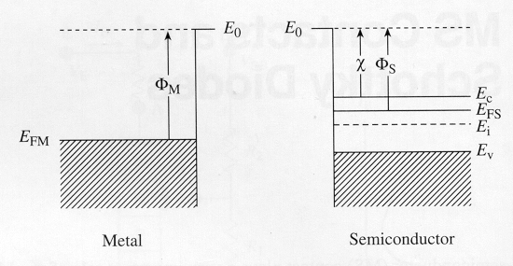
Ideal MS contacts
Assumptions - Ideal MS contacts
  M and S are in intimate contact, on atomic scale
  No oxides or charges at the interface
  No intermixing at the interface

Slide 3

MS contacts
Vacuum level, E₀ - corresponds to energy of free electrons.
The difference between vacuum level and Fermi-level is called workfunction, Φ of materials.
  Workfunction, Φ_{M} is an invariant property of metal. It is the minimum energy required to free up electrons from metal. (3.66 eV for Mg, 5.15eV for Ni etc.)
The semiconductor workfunction, Φ_{s}, depends on the doping.
where χ = (E₀ – E_{C})|_{SURFACE} is a a fundamental property of the semiconductor. (Example: χ = 4.0 eV, 4.03 eV and 4.07 eV for Ge, Si and GaAs respectively)

Slide 4
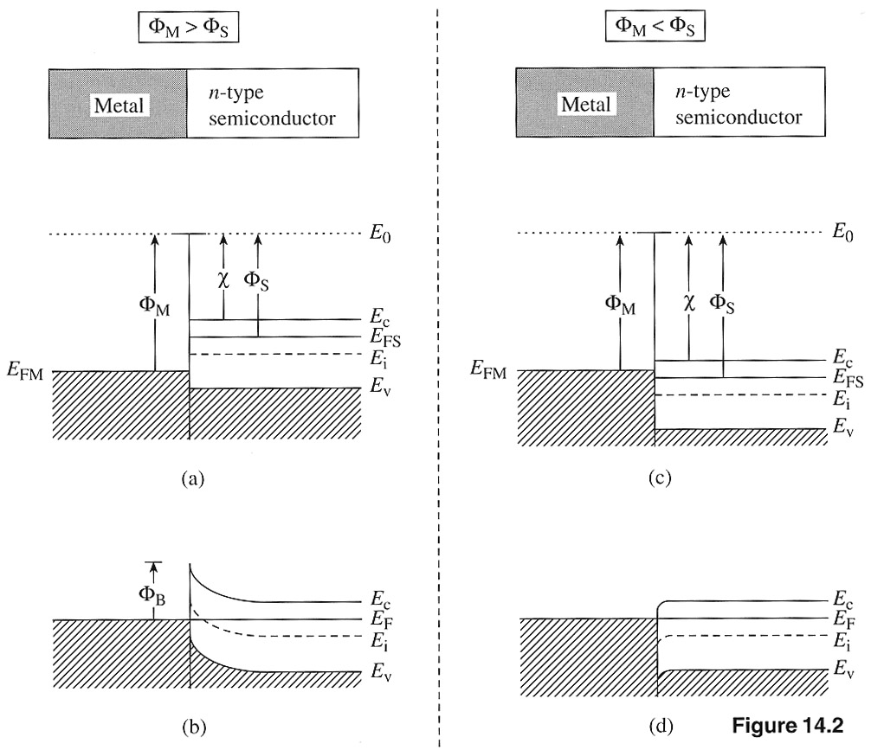
Energy band diagrams for ideal MS contacts
(a) and (c) An instant
after contact formation
(b) and (d) under
equilibrium conditions
Φ_{M} > Φ_{S}
Φ_{M} < Φ_{S}

Slide 5
MS (n-type) contact with Φ_{M} > Φ_{S}
Soon after the contact formation, electrons will begin to flow from S to M near junction.
Creates surface depletion layer, and hence a built-in electric field (similar to p⁺-n junction).
Under equilibrium, net flow of carriers will be zero, and Fermi-level will be constant.
A barrier Φ_{B} forms for electron flow from M to S.
Φ_{B} = Φ_{M} – χ ... ideal MS (n-type) contact. Φ_{B} is called “barrier height”.
Electrons in semiconductor will encounter an energy barrier equal to Φ_{M} – Φ_{S} while flowing from S to M.

Slide 6
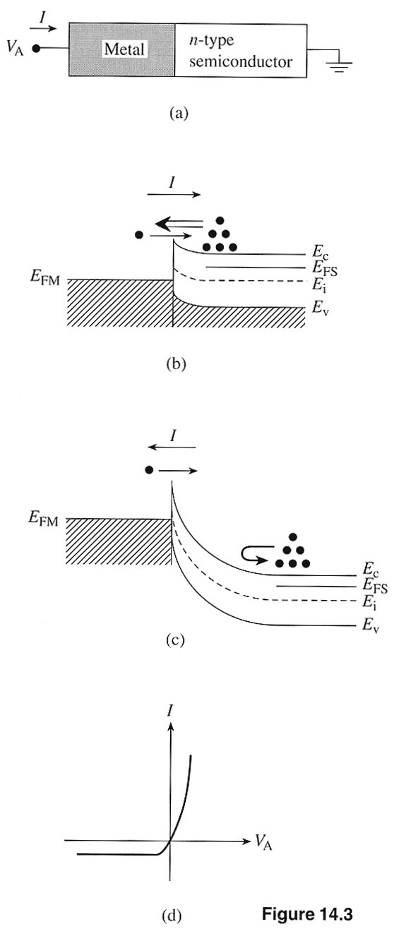
MS (n-type) contact with Φ_{M} > Φ_{S}
Response to applied bias for n-type semiconductor
Note: An applied positive voltage lowers the band since energy bands are drawn with respect to electron energy.

Slide 7
MS (n-type) contact with Φ _{M} < Φ_{S}
No barrier for electron flow from S to M. So, even a small V_{A} > 0 results in large current.
As drawn, small barrier exists for electron flow from M to S, but vanishes when V_{A}< 0 is applied to the metal. Large current flows when V_{A}< 0.
The MS(n-type) contact when Φ_{M} < Φ_{S} behaves like an ohmic contact.
I
V_{A}

Slide 8
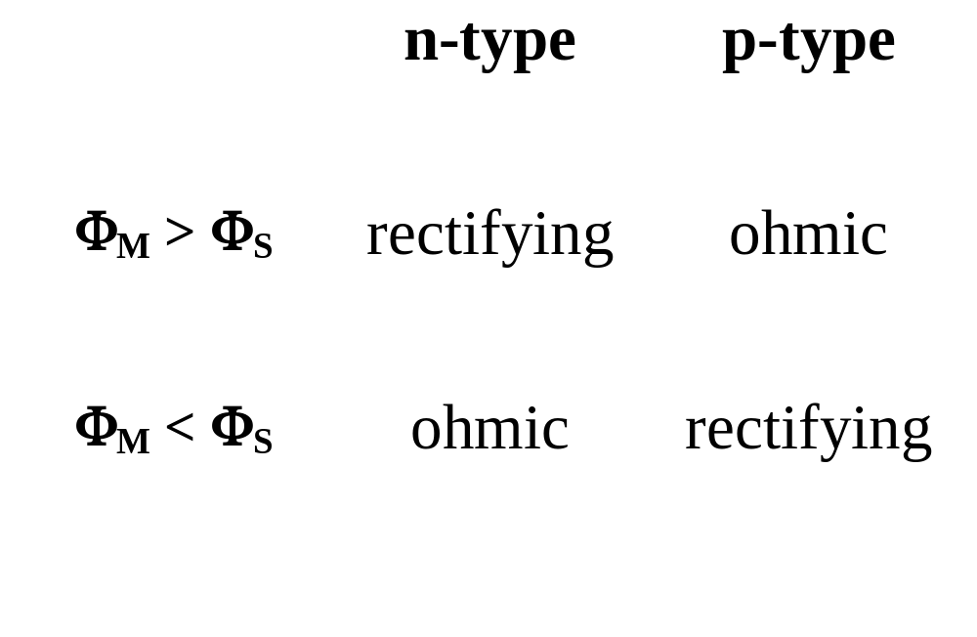
Table 14.1 Electrical nature of ideal MS contacts

Slide 9
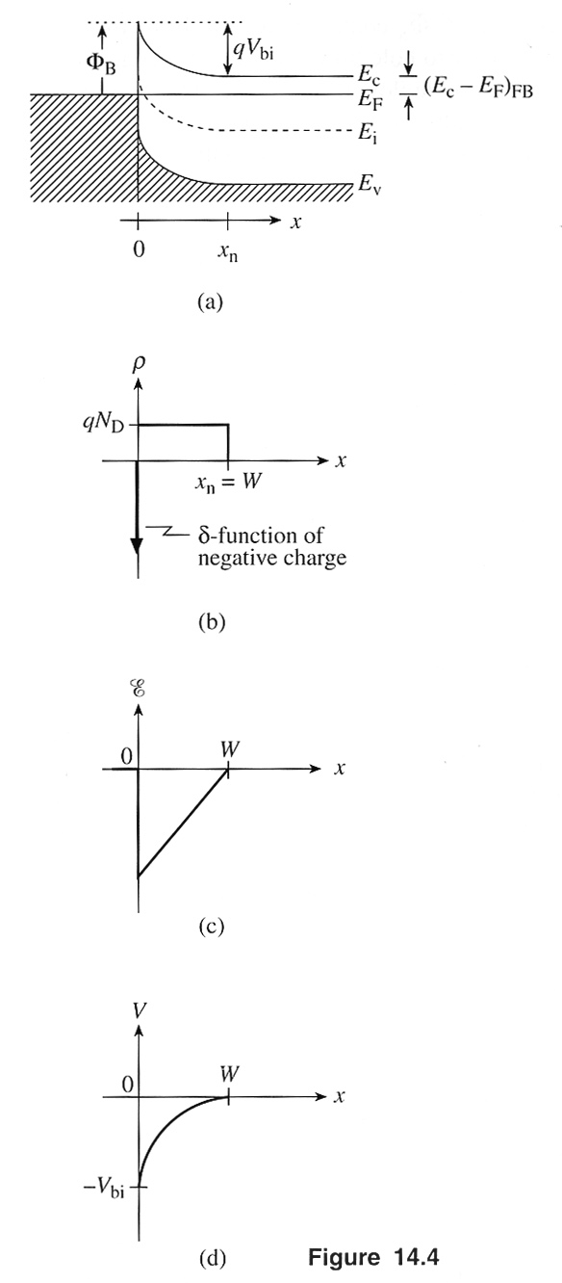
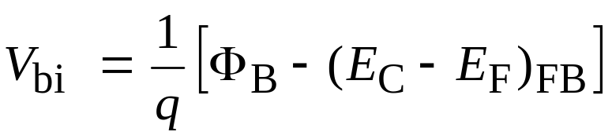
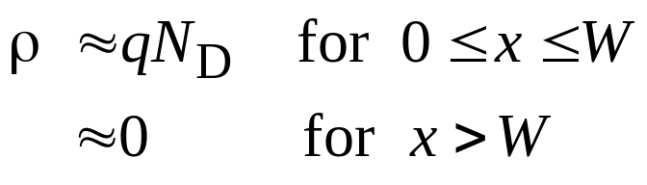
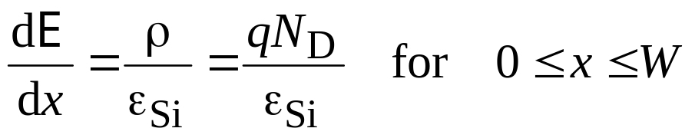
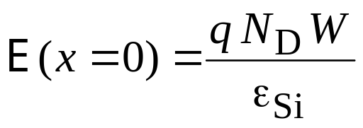
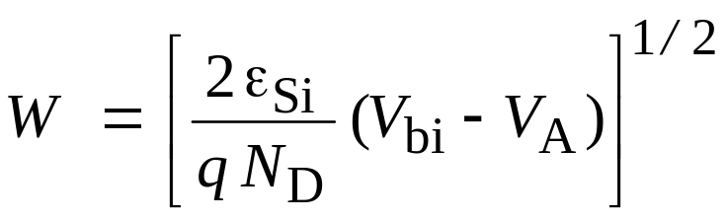
Schottky diode

Slide 10

Example
Find barrier height, built-in voltage, maximum E-field, and the
depletion layer width at equilibrium for W-Si (n-type) contact.
Given: Φ_{M} = 4.55eV for W; χ(Si) = 4.01eV; Si doping = 10¹⁶ cm⁻³
Draw the band diagram at equilibrium.
Solution:
Find E_{F} – E_{i} E_{F} – E_{i} = 0.357eV
Find E_{C} – E_{F} E_{C} – E_{F} = 0.193eV
Φ_{B} = Φ_{M} – χ = 0.54eV
V_{bi} = 0.347 V
W = 0.21 μm
E(x = 0) = E_{max} = 3.4 × 10⁴ V/cm

Slide 11
Chapter 14-2. Schottky diode I-V characteristics
Schottky diode is a metal-semiconductor (MS) diode
Historically, Schottky diodes are the oldest diodes
MS diode electrostatics and the general shape of the MS diode I-V characteristics are similar to p⁺n diodes, but the details of current flow are different.
Dominant currents in a p⁺n diode
  arise from recombination in the depletion layer under small forward bias.
  arise from hole injection from p⁺ side under larger forward bias.
Dominant currents in a MS Schottky diodes
  Electron injection from the semiconductor to the metal.

Slide 12
Current components in a p⁺n and MS Schottky diodes
M n-Si
p⁺
n
dominant
negligible
Φ_{B}
I_{r-g}
I_{R-G}
negligible
dominant

Slide 13
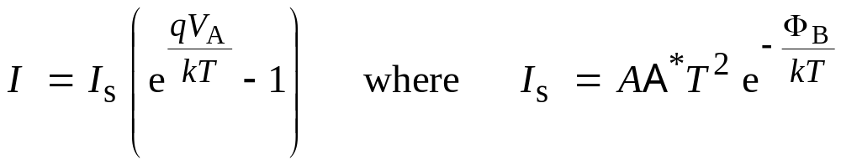
I-V characteristics
where Φ_{B} is Schottky barrier height, V_{A} is applied voltage, A is area, and A* is Richardson’s constant.
The reverse leakage current for a Schottky diode is generally much larger than that for a p⁺n diode.
Since MS Schottky diode is a majority carrier devices, the frequency response of the device is much higher than that of
equivalent p⁺ n diode.

